Slide 1
Management of Hypertension
Digital Medicine Best Practice Guidelines (BPGs)
Clinical Guideline Standard: 2025 ACC/AHA Guideline for Management of HTN

Slide 2
Executive Summary
Objective: Advance Digital Medicine as a comprehensive care model that slows chronic disease progression, improves patient outcomes, and reduces total care costs.
Key Updates:
Best Practice Pathways (BPPs): Standardize care delivery by clarifying and streamlining clinical decision-making
Evidence-Based Design: Developed by Digital Medicine Clinical Leadership using national guidelines, expert opinion, and the latest clinical evidence.
Living Documents: Adaptable to evolving clinical knowledge and patient needs.
Goals of the BPPs:
Improved Outcomes: Drive measurable health improvements through targeted interventions.
Optimized Care Delivery: Enhance efficiency, reduce clinical inertia, and support complex case management.
Continuous Quality Improvement: Monitor performance and identify opportunities for enhancement.
Enhanced Stakeholder Confidence: Build trust with consistent, evidence-based care.
What’s New for HTN:
Best Practice Pathways: Clear algorithms ensure efficient medication management.
Primary Aldosteronism Screening: Focus on timely identification, Endocrinology referrals, and lab-guided management for complex hypertension cases.
Hyperkalemia Management: Guidance on steps to take in patients with hyperkalemia.
Clinical Care Gaps: Details specific clinical interventions to review for in each patient.

Slide 3
Topics Covered
New Patient Review Task Checklist
Medication Adherence
Blood Pressure Target selection
Best Practice Pathways
Treatment-Naïve
Uncontrolled Patients Already on Treatment
Resistant Hypertension
Primary Aldosteronism Screening
Resistant HTN without Clear Cause
Management of Aldosterone Excess
Special Populations
Women of childbearing age
Older Adults (age >75 years)
Atrial Fibrillation
Black/African American
Cardiovascular Disease and Risk Management
Chronic Kidney Disease and Albuminuria Management
Optimizations and Clinical Pearls
When to Escalate Patient Cases

Slide 4
New Patient Review Task Checklist
Pre-Call Review:
Review recent primary care and specialist encounters for pertinent information.
Review for pertinent history and comorbidities.
Review recent data.
Review medication history for previous trials and intolerances.
Review adherence (PDC) data for current regimen and note potential issues.
Prepare a tentative medication management plan based on the selected BPP.
During the Call:
Confirm patient understanding of the program.
Assess patient understanding of and adherence to their medication regimen.
Discuss recent data.
Assess for device or technique issues.
Engage in goal-setting
Discuss and implement the highest priority medication optimization.
Schedule next follow-up

Slide 5
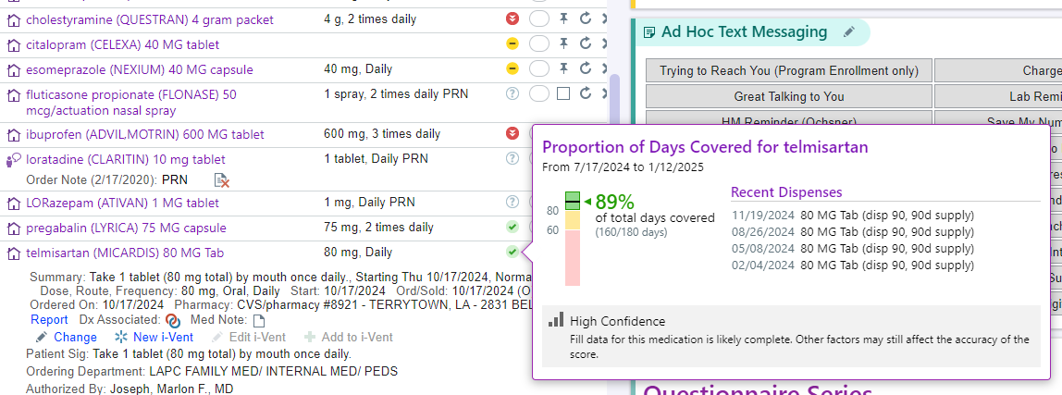
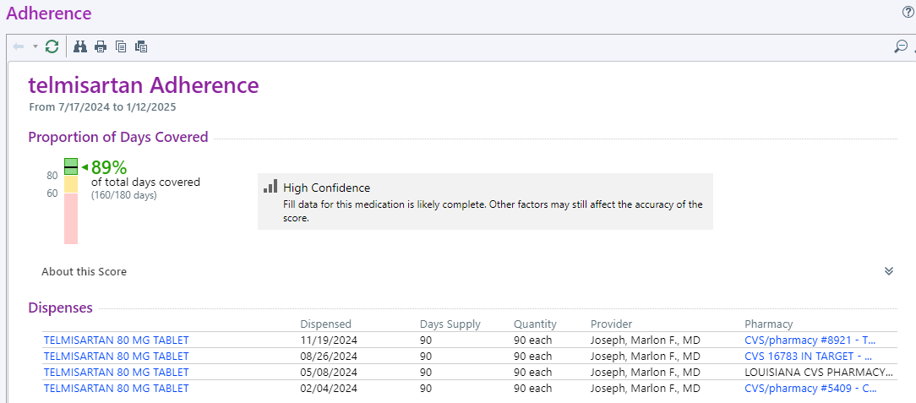
Medication Adherence
Care Tab – Medication List
Review the PDC data of pertinent medications before each call.
Discuss with patient if any concerns are identified.
If what patient states is incongruent with the PDC data or if the PDC data appears to be inaccurate, call the pharmacy directly to review the recent fill history.
If pharmacy fill history reveals concern for non-adherence, begin motivational interviewing to determine root cause.
View after clicking the PDC symbol

Slide 6
Blood Pressure Target Selection
The standard target for all patients is <130/80 mmHg.
For patients with multiple complicating factors, present at Clinician Case Review to determine if <140/90 mmHg goal is appropriate.
NOTE: For patients with any of the comorbid diagnoses below, tight BP control (average well below 130/80) is essential to maximize outcomes if able to be achieved safely.
CKD
Diabetes
Aortic aneurysm
Vascular dementia/Cerebral amyloid angiopathy (CAA)
Examples of complicating factors:
Multiple medication intolerances limiting available options
High burden of comorbidities
Very labile blood pressure
Conditions associated with autonomic dysfunction:
Orthostatic hypotension
Postural tachycardic syndrome [POTS]
Parkinson’s
Severe diabetic neuropathy
Jones DW et al; Circulation. 2025.
Taler, S. J., & Whelton, P. K. (2023). Goal blood pressure in adults with hypertension. In T. W. Post (Ed.), UpToDate.

Slide 7
Best Practice Pathways (BPPs)

Slide 8
Using the BPPs
Review patient chart for compelling indications.
Based on current treatment regimen, presence of compelling indications (diabetes, CKD, albuminuria, HF, or ASCVD), and any pertinent patient-specific factors, select the most appropriate treatment pathway to follow.
If patient remains uncontrolled after a completing a step, move on the next step. Continue to follow the steps of the selected treatment pathway until the patient is controlled, meets the definition for resistant HTN, or warrants further assessment at Clinician Case Review/Clinical Roundtable.
If a patient is unable to tolerate a specific class (after confirming a retrial is inappropriate), move on to the next step in the pathway.

Slide 9
Treatment Naïve – No Compelling Indications
Starting with amlodipine and an ARB as the initial two agents is supported generally by the guidelines and specifically by expert opinion.
Justification stems primarily from the ACCOMPLISH trial, though completed in 2008 and used an ACE inhibitor, demonstrated significantly better cardiovascular outcomes.
For patients with BP avg >140/90 mmHg, single-pill combination of amlodipine/ARB should be started and then titrated based on response.
If uncontrolled on amlodipine 5 mg/day, adding an ARB (using single-pill combination) is preferred over titrating to 10 mg/day to mitigate side effects and increase the chances of achieving the BP target.
If still uncontrolled, add potent thiazide.
Alternatives:
HCTZ as part of triple combination product to reduce pill burden.
Torsemide in place of a thiazide for a patient with CKD4 and signs/symptoms of hypervolemia (e.g., SOB, orthopnea, peripheral edema, etc.).
If HCTZ is used, dose should start at 25 mg unless concerned about tolerance (e.g., gout flare risk, elderly/frail, etc.).
If HCTZ used first and still uncontrolled, switch to potent thiazide.
Review for appropriate baseline BMP before starting ARB/thiazide and 2-4 weeks after initiation and then, if stable, consider rechecking with subsequent dose changes.
Jones DW et al; Circulation. 2025.
Jamerson K et al. ACCOMPLISH trial. N Engl J Med 2008;359:2417-2428.
Wald DS et al. Am J Med 2009; 122(3):290–300.
Whelton, P. K., & Taler, S. J. (2023). Choice of drug therapy in primary (essential) hypertension. In T. W. Post (Ed.), UpToDate.

Slide 10
Treatment Naïve – RAAS First
For patients with CKD, albuminuria, HF, or ASCVD (or diabetes as a soft indication)
Starting with an ARB and amlodipine as the initial two agents is supported generally by the guidelines and specifically by expert opinion.
Justification stems from the ACCOMPLISH trial, though completed in 2008 and used an ACE inhibitor, demonstrated significantly better cardiovascular outcomes.
For patients with BP avg >140/90 mmHg, single-pill combination of amlodipine/ARB should be started and then titrated based on response.
If still uncontrolled, add potent thiazide.
Alternatives:
HCTZ as part of triple combination product to reduce pill burden.
Torsemide in place of a thiazide for a patient with CKD4 and signs/symptoms of hypervolemia (e.g., SOB, orthopnea, peripheral edema, etc.).
If HCTZ is used, dose should start at 25 mg unless concerned about tolerance (e.g., gout flare risk, elderly/frail, etc.).
If HCTZ used first and still uncontrolled, switch to potent thiazide.
Review for appropriate baseline BMP before starting ARB/thiazide and 2-4 weeks after initiation and then, if stable, consider rechecking with subsequent dose changes.
Jones DW et al; Circulation. 2025.
Jamerson K et al. ACCOMPLISH trial. N Engl J Med 2008;359:2417-2428.
Wald DS et al. Am J Med 2009; 122(3):290–300.
Whelton, P. K., & Taler, S. J. (2023). Choice of drug therapy in primary (essential) hypertension. In T. W. Post (Ed.), UpToDate.
El Sayed NA, et al. Diabetes Care December 2024, Vol.48, S1-S5.
Eknoyan G et al. Kidney International (2024) 105 (Suppl 4S), S117–S314

Slide 11
Uncontrolled Patients Already on Treatment
Use the pathways on the next 3 slides for uncontrolled patients already on 1st line treatment.
If the patient is on at least one 1st line option, start from the left of the algorithm and go down the first section you answer “Yes” to. Then implement the optimizations in that section before moving on.
If a patient is not on any 1st line treatment options, although not technically treatment naïve, follow the most appropriate treatment naïve pathway based on presence of compelling indications.
If a patient is unable to use any of the 1st line treatment options, focus on optimizing their current treatment regimen, if possible, and consider presenting at Clinician Case Review to determine the next best option.
Note: If there is a history of intolerance, investigate further to determine if a retrial is appropriate. If so, perform retrial.
Start the Resistant HTN pathway once you have implemented all optimizations within the algorithm.

Slide 12
Uncontrolled Patient on ACE/ARB
Use this pathway to optimize a patient’s ACE/ARB first.
This is especially important for those with CKD, albuminuria, HF, or ASCVD (or diabetes as a soft indication)
Key Point: When a patient is not close to goal, adding amlodipine in place of titrating the ACE/ARB (using a single-pill combination) is preferred because it is much more effective and minimizes the side effects of both agents.
Jones DW et al; Circulation. 2025.
Jamerson K et al. ACCOMPLISH trial. N Engl J Med 2008;359:2417-2428.
Whelton, P. K., & Taler, S. J. (2023). Choice of drug therapy in primary (essential) hypertension. In T. W. Post (Ed.), UpToDate.

Slide 13
Uncontrolled Patient on DHP CCB
Use this pathway to optimize a patient’s DHP CCB.
Key Point: When a patient is not close to goal, adding amlodipine in place of titrating the ACE/ARB (using a single-pill combination) is preferred because it is much more effective and minimizes the side effects of both agents.
Jones DW et al; Circulation. 2025.
Jamerson K et al. ACCOMPLISH trial. N Engl J Med 2008;359:2417-2428.
Whelton, P. K., & Taler, S. J. (2023). Choice of drug therapy in primary (essential) hypertension. In T. W. Post (Ed.), UpToDate.

Slide 14
Uncontrolled Patient on Thiazide
Use this pathway to optimize a patient’s thiazide.
Key Point: when a patient is not close to goal and they’re on HCTZ, switching to chlorthalidone or indapamide is the preferred option.
Jones DW et al; Circulation. 2025.
Jamerson K et al. ACCOMPLISH trial. N Engl J Med 2008;359:2417-2428.
Whelton, P. K., & Taler, S. J. (2023). Choice of drug therapy in primary (essential) hypertension. In T. W. Post (Ed.), UpToDate.

Slide 15
Resistant HTN
Confirm patient meets the definitions of resistant HTN
Exclude pseudoresistance
Investigate secondary causes
Manage according to secondary causes, or absence thereof
Jones DW et al; Circulation. 2025.
Carey, R. M. (2023). Treatment of resistant hypertension. In T. W. Post (Ed.), UpToDate.

Slide 16
Resistant HTN – Confirm Definition
Uncontrolled BP
Controlled BP
On 3 optimized medication classes
One must be a maximally tolerated thiazide (optimal: chlorthalidone or indapamide)
On ≥4 maximally tolerated medication classes
Jones DW et al; Circulation. 2025.
Carey, R. M. (2023). Treatment of resistant hypertension. In T. W. Post (Ed.), UpToDate.

Slide 17
Resistant HTN – Exclude Pseudoresistance
Pseudoresistance occurs when there is a patient-related factor present that is negatively impacting BP measurement and/or control.
Treatment non-adherence → identify reasons (side effects, pill burden, cost, etc.) and address, if possible.
BP technique → ensure patient following appropriate measurement steps and cuff fits properly and rule out defective monitor. Address as applicable.
Lifestyle → identify opportunities for improvement and, if appropriate, enter HC intervention.
Interfering substances → NSAIDs, stimulants (including caffeine), alcohol etc. Address if possible.
NOTE: You may move on to the investigation into secondary causes if a factor remains an issue, either because the patient is unable to or refuses to address it.
Jones DW et al; Circulation. 2025.
Carey, R. M. (2023). Treatment of resistant hypertension. In T. W. Post (Ed.), UpToDate.

Slide 18
Secondary Causes – Obstructive Sleep Apnea
If diagnosed, assess adherence to CPAP/BiPAP.
If undiagnosed, assess risk using STOP-BANG questionnaire.
Message RP of sleep study recommendation if indicated.
Jones DW et al; Circulation. 2025.
Carey, R. M. (2023). Treatment of resistant hypertension. In T. W. Post (Ed.), UpToDate.

Slide 19
Secondary Causes – Primary Aldosteronism
Indications for aldosterone/renin activity lab:
Confirmed resistant HTN (regardless of hypokalemia), OR
Presence of uncontrolled HTN and hypokalemia (spontaneous or diuretic-induced)
Scenarios which do not require confirmation testing (i.e., salt loading protocol) and can go straight to Endo referral for additional imaging/testing, if desired:
Renin activity <1 and aldosterone >30
Renin activity <1, aldosterone 20-30, and history of spontaneous hypokalemia
Ordering Process:
Enter aldosterone/renin activity order (LAB2043) and schedule a lab visit in a fasting lab slot as close to 8am as possible. Instruct patient to sit up straight in a chair during the lab draw. For night shift workers, it’s okay to schedule the lab on a day off around the time they typically wake up.
Enter a BMP order (LAB15) to ensure this is up-to-date and to support interpretation of the aldosterone/renin activity results.
For patients using Quest or needing to using the Brees clinic lab: Enter plasma aldosterone (LAB557) and plasma renin activity (LAB532) separately.
Follow the pathway on the next slide once the aldosterone/renin activity lab is resulted.
Jones DW et al; Circulation. 2025.
Adler GK et al. The Journal of Clinical Endocrinology & Metabolism. 2025
Funder, J. W., & Carey, R. M. (2023). Diagnosis of primary aldosteronism. In T. W. Post (Ed.), UpToDate.

Slide 20
Secondary Causes – Primary Aldosteronism
Jones DW et al; Circulation. 2025.
Adler GK et al. The Journal of Clinical Endocrinology & Metabolism. 2025
Funder, J. W., & Carey, R. M. (2023). Diagnosis of primary aldosteronism. In T. W. Post (Ed.), UpToDate.

Slide 21
Clinical Pearls – Primary Aldosteronism
Many cases of aldosterone excess are normokalemic. However, if potassium is currently low, replete it according to the potassium repletion table on Slide 50 before getting the lab drawn. This will improve the accuracy of the aldosterone/renin activity result.
Other antihypertensive medications, including ACE/ARB, do not need to be stopped.
If patient is already on spironolactone/eplerenone, present patient at Clinical Roundtable to determine if primary aldosteronism investigation is warranted.
Younger patients (especially those <50 years old) are the most likely to have a unilateral adrenal adenoma as the cause because the incidence of this condition decreases as age increases. Older patients are more likely to have bilateral adrenal hyperplasia, of which surgery is not a treatment option. However, it is still possible for an older patient to have a unilateral adrenal adenoma; and some healthy, older, surgically appropriate patients may still opt for confirmatory testing and possible surgical intervention. Use talking points below for discussion with the patient.
Surgical candidates must:
Be willing to undergo confirmatory testing including salt loading protocol (if indicated), adrenal venous sampling (an invasive procedure) and adrenal imaging to confirm the presence of a unilateral adrenal adenoma.
Be medically cleared for surgery (i.e., absence of conditions such as heart failure or significant coronary artery disease).
Most patients will not qualify for surgery (either due to bilateral adrenal hyperplasia or not being medically cleared) and should be managed medically with MRA.
When in doubt, refer to Endocrinology, but do not delay starting MRA in patients with severely uncontrolled HTN (BP avg ≥150/90) while waiting for an appointment. If Endocrinology decides on further evaluation, they can pause MRA therapy as needed.
To coordinate Endo referral:
For internal patients: Send message to PCP using smartphrase .DMRESISTANTHTN after filling out the necessary information.
For external patients: Send message to patient using smartphrase .DMEXTERNALRESISTANTHTN after filling out the necessary information. Instruct the patient to forward the message to their PCP.
If the outcome of the patient discussion or Endo referral is medical management, manage according to the pathway on Slide 25.
If the lab results rule out primary aldosteronism, manage according to the most appropriate BPP, or the pathway on Slide 24 if patient meets criteria for resistant HTN.
Jones DW et al; Circulation. 2025.
Adler GK et al. The Journal of Clinical Endocrinology & Metabolism. 2025
Funder, J. W., & Carey, R. M. (2023). Diagnosis of primary aldosteronism. In T. W. Post (Ed.), UpToDate.

Slide 22
Secondary Causes – Primary Aldosteronism
Jones DW et al; Circulation. 2025.
Adler GK et al. The Journal of Clinical Endocrinology & Metabolism. 2025
Funder, J. W., & Carey, R. M. (2023). Diagnosis of primary aldosteronism. In T. W. Post (Ed.), UpToDate.

Slide 23
Primary Aldosteronism – Sodium Loading Protocol
Safety Considerations:
Serum potassium must be corrected before proceeding with the protocol.
Assess the safety and appropriateness of undergoing the protocol based on the current BP control and comorbidities. Should avoid the protocol for patients with any of the following:
Avg SBP >160 or DBP >100
HF
eGFR <30
Presence of significant edema
Sodium loading protocol for confirmation testing – Send instructions to patient using .DMSODIUMLOADING smartphrase.
Enter orders:
Prescription for NaCl 1g tablets: Take 2 tablets every 8 hours, #18, 0 refills
Prescription for KCl 10 mEq tablets: Take 1 tablet twice daily, #6, 0 refills (to prevent hypokalemia during the protocol)
BMP – LAB15
Aldosterone, urine, 24 hour - LAB354
Creatinine, urine, timed - LAB385
Sodium, urine, timed - LAB445
Day 1 and 2: Patient takes NaCl tablets as prescribed.
Day 3:
Patient starts to collect urine after waking up.
Patient takes NaCl tablets as prescribed.
Day 4: BMP is drawn any time after 0800 when the 24-hr urine specimen is returned.
Interpretation:
Urine sodium secretion must be >200 mEq to be a good sample. If this is not met, the protocol must be repeated.
Test is positive if urine aldosterone excretion >12 mcg/24hr.
If test is negative, patient still has evidence of aldosterone excess and should be managed medically with MRA therapy by following the aldosterone excess pathway.
Jones DW et al; Circulation. 2025.
Adler GK et al. The Journal of Clinical Endocrinology & Metabolism. 2025
Funder, J. W., & Carey, R. M. (2023). Diagnosis of primary aldosteronism. In T. W. Post (Ed.), UpToDate.

Slide 24
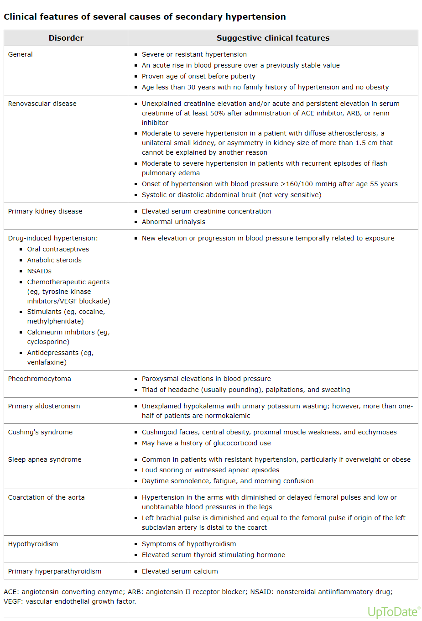
Resistant HTN – Evaluation of Secondary Causes
UpToDate - Clinical Clues for Secondary Causes
Patients may present with signs/symptoms of possible secondary causes other than OSA or primary aldosteronism.
Present these patients at Clinician Case review to determine if further investigation is appropriate and to develop a plan to communicate with Responsible Provider who will enter orders and interpret results.
If a diagnosis is made, continue to manage medications until appropriate specialist further evaluates.
Jones DW et al; Circulation. 2025.
Carey, R. M. (2023). Treatment of resistant hypertension. In T. W. Post (Ed.), UpToDate.

Slide 25
Resistant HTN – Management without Clear Secondary Cause
Start spironolactone as 4th option.
Ensure any potassium supplementation (Rx and OTC) has been discontinued.
Recheck BMP in 2-4 weeks or <2 weeks if higher risk for hyperkalemia (e.g., eGFR <30, h/o hyperkalemia, potassium at upper limit of normal, etc.)
Double the dose if potassium and kidney function is stable and patient is tolerating.
If male patients develop symptoms of gynecomastia/breast tenderness or ED, switch to eplerenone. Consider using eplerenone first if patient wishes to avoid these and there is no cost concern.
Spironolactone: max dose 100 mg once daily
If eGFR ≥50: start at 25 mg once daily
If eGFR <50: start at 12.5 mg daily
Eplerenone: max dose 50 mg twice daily
If eGFR ≥50: start at 50 mg once daily
If eGFR <50: start at 25 mg once daily
Jones DW et al; Circulation. 2025.
Carey, R. M. (2023). Treatment of resistant hypertension. In T. W. Post (Ed.), UpToDate.

Slide 26
Management of Aldosterone-excess State
Start spironolactone
Ensure any potassium supplementation (Rx and OTC) has been discontinued.
Recheck BMP in 2-4 weeks or <2 weeks if higher risk for hyperkalemia (e.g., eGFR <30, h/o hyperkalemia, potassium at upper limit of normal, etc.)
Recheck renin activity (LAB532) 4-6 weeks after initiation and doses changes.
Double the dose until renin activity >1 if potassium and kidney function are stable and patient is tolerating (i.e., no max dose).
May need to taper or discontinue other medications to support spironolactone dose titration.
If male patients develop symptoms of gynecomastia/breast tenderness or ED, switch to eplerenone. Consider using eplerenone first if patient wishes to avoid these and there is no cost concern.
If a patient becomes uncontrolled on a dose of spironolactone that previously normalized renin activity, recheck renin activity (and BMP if needed). If renin activity <1 again (and BMP stable), consider increasing spironolactone dose if patient tolerating current dose.
Jones DW et al; Circulation. 2025.
Adler GK et al. The Journal of Clinical Endocrinology & Metabolism. 2025
Funder, J. W., & Carey, R. M. (2023). Diagnosis of primary aldosteronism. In T. W. Post (Ed.), UpToDate.

Slide 27
5th Option Selection
Key points:
Consider patient-specific factors including medical history, risk of specific side effects, and patient preferences.
If selection unclear, present patient at Clinician Case Review.
Consider using a vasodilating beta-blocker (carvedilol) first, especially if:
A patient’s resting HR >70 bpm, or
There’s a compelling indication (e.g., post-MI, heart failure, Afib, portal HTN), to use one but patient not currently taking
If a beta-blocker is not tolerated or contraindicated, consider a centrally acting agent like clonidine (weekly patch preferred) or guanfacine (dosed at bedtime).
If a beta-blocker and centrally acting agent are not tolerated, consider diltiazem ER (in patients without heart failure).
Note: This can be used in combination with a DHP CCB like amlodipine after considering patient preferences and weighing the risk of increased side effects.
Jones DW et al; Circulation. 2025.
Carey, R. M. (2023). Treatment of resistant hypertension. In T. W. Post (Ed.), UpToDate.
Alviar CL et al. American Journal of Hypertension, Volume 26, Issue 2, February 2013, Pages 287–297

Slide 28
6th Option Selection
Key points:
Consider patient-specific factors including medical history, risk of specific side effects, and patient preferences.
If selection unclear, present patient at Clinician Case Review.
Options:
Hydralazine – Can be useful in a patient with HFrEF (already optimized on beta-blocker, loop diuretic)
Alpha blocker – Can be useful in a patient with concomitant BPH or PTSD-related dreams (prazosin)
Jones DW et al; Circulation. 2025.
Carey, R. M. (2023). Treatment of resistant hypertension. In T. W. Post (Ed.), UpToDate.

Slide 29
Special Populations

Slide 30
Women of Childbearing Age (18-45 years)
This algorithm is used for the following patients:
Those who are actively going through family planning.
Those who are unable to or choose not to use a reliable form of birth control.
Review for appropriate baseline BMP before starting a thiazide and 2-4 weeks after initiation and then, if stable, consider rechecking with subsequent dose changes.
NOTE: The other BPPs may be used in the following patients after risk-benefit discussion:
Those who are physically unable to get pregnant (e.g., history of hysterectomy, bilateral salpingo-oophorectomy, tubal ligation).
Those who are on long-acting reversible contraception (e.g., IUDs, contraceptive implants).
Those who are on hormonal contraception or using condoms and are not actively going through family planning.
Jones DW et al; Circulation. 2025.
Whelton, P. K., & Taler, S. J. (2023). Choice of drug therapy in primary (essential) hypertension. In T. W. Post (Ed.), UpToDate.

Slide 31
Older Adults (Age >75 years)
HTN prevalence as high as 82% in this age group.
There is a similar relative risk reduction with aggressive BP lowering but great absolute benefits compared to younger patients.
Isolated systolic HTN is common because diastolic pressure gradually declines after age 60 years.
Dizziness, fatigue, and lightheadedness are common but may not indicate orthostatic hypotension:
Orthostatic hypotension is a drop in blood pressure upon standing, defined as a decrease in systolic BP by ≥20 mm Hg or diastolic BP by ≥10 mm Hg within 3 minutes of standing. It results from impaired autonomic regulation, dehydration, medications, or underlying conditions like diabetes or Parkinson’s disease.
Common symptoms include dizziness, lightheadedness, blurred vision, and fainting (syncope), typically upon standing quickly. Severe cases may lead to falls or injury.
Jones DW et al; Circulation. 2025.
Whelton, P. K., & Taler, S. J. (2023). Choice of drug therapy in primary (essential) hypertension. In T. W. Post (Ed.), UpToDate.

Slide 32
Older Adults (Age >75 years)
Isolated Systolic HTN:
To prevent or minimize Orthostatic Hypotension:
If treatment-naïve without compelling indications, a DHP CCB can be particularly effective.
If already on ACE/ARB or DHP CCB, add the other class.
Use of a thiazide diuretic should be reserved as 3rd line.
Start at low doses and titrate slowly – usually half that of younger adults.
Avoid alpha blockers, central adrenergic inhibitors (clonidine), nitrates, if possible.
Jones DW et al; Circulation. 2025.
Whelton, P. K., & Taler, S. J. (2023). Choice of drug therapy in primary (essential) hypertension. In T. W. Post (Ed.), UpToDate.

Slide 33
Atrial Fibrillation
Patients will likely already be on a beta blocker or non-DHP CCB for rate control.
Use the most appropriate pathway to determine the next best option if patient is uncontrolled.
It may be more difficult to obtain accurate blood pressure measurements in patients with atrial fibrillation and high beat-to-beat BP variability or high heart frequency → multiple readings can be useful to minimize this.
Jones DW et al; Circulation. 2025.
Whelton, P. K., & Taler, S. J. (2023). Choice of drug therapy in primary (essential) hypertension. In T. W. Post (Ed.), UpToDate.
Feenstra RK, Allaart CP, Berkelmans GFN, et al. Blood Press Monit 2018; 23:59.

Slide 34
Black/African American Patients
Please follow the same treatment pathways (Slides 9-14) based on their current regimen and compelling indications – regardless of race/ethnicity.
Jones DW et al; Circulation. 2025.
Whelton, P. K., & Taler, S. J. (2023). Choice of drug therapy in primary (essential) hypertension. In T. W. Post (Ed.), UpToDate.

Slide 35
Cardiovascular Disease and Risk Management

Slide 36
Heart Failure Overview
The management of HTN and heart failure is closely interconnected, as optimal blood pressure control plays a critical role in preventing HF progression and improving outcomes.
HFrEF (EF ≤40%)
Impaired systolic function → decreased cardiac output
Neurohormonal activation: RAAS, SNS → volume retention, vasoconstriction
Use of appropriate guideline-direct medication therapy (GDMT) is essential to reduce mortality and hospitalizations
HFpEF (EF ≥50%)
Preserved systolic function with impaired diastolic relaxation
Often driven by HTN, LVH, and comorbidities like DM and CKD
Aggressive management of comorbidities is essential to reduce overall risk
Some medications (e.g., SGLT2 inhibitors and MRAs) have mortality benefit
Loop diuretics may be necessary to manage symptoms of volume overload
Shared Mechanisms:
RAAS activation, endothelial dysfunction, inflammation, and volume overload
Heidenreich PA et al. Circulation. 2022;145:e895–e1032
Jones DW et al; Circulation. 2025.
Meyer TE (2025). Primary pharmacologic therapy for heart failure with reduced ejection fraction. In T. W. Post (Ed.), UpToDate.

Slide 37
HF Stages
Heidenreich PA et al. Circulation. 2022;145:e895–e103
Describes the progression of heart failure (all classifications) from risk factors to advanced disease
Based on structural changes and symptom history, not current symptoms alone
Unidirectional: once a patient progresses to a higher stage, they do not revert to a lower stage
Guides preventive strategies, initiation of GDMT (in HFrEF), and timing of advanced interventions
Complements, but differs from, the NYHA classification, which reflects current symptom severity
Stages of HF |  | Criteria and Chart Review Clues
A: At risk for HF | No structural heart disease or symptoms of HF | Any of the following on the problem list: HTN Diabetes Obesity CAD
B: Pre-HF | Structural heart disease but no prior or current signs or symptoms of HF | Evidence of 1 of the following: Structural heart disease (e.g., EF ≤40%, left ventricular hypertrophy, left atrial enlargement, segmental wall motion abnormalities, valvular heart disease [e.g., moderate/severe aortic stenosis or mitral regurgitation]; see Card Proc section and look for ECHO result) Increased filling pressures (see Card Proc section and look for ECHO result) Presence of risk factors and positive biomarkers (e.g., BNP >50, NT-proBNP >125, high-sensitivity troponin above reference range; see labs section) in the absence of a competing diagnosis (e.g., MI, ACS, etc.)
C: Symptomatic HF | Structural heart disease with prior or current symptoms of HF | Same clues as Stage B plus any documentation of dyspnea on exertion, orthopnea, edema, etc.
D: Advanced HF | Persistent symptoms and recurrent HF hospitalizations despite optimal GDMT or attempts to optimize GDMT | Have persistent NYHA IV symptoms Are hospitalized repeatedly Cannot tolerate or respond to GDMT or use of alternative medications (e.g., digoxin, vericiguat) Require advanced therapies like inotropes, LVAD, or transplant referral

Slide 38
NYHA Classification
Heidenreich PA et al. Circulation. 2022;145:e895–e103
Describes the severity of heart failure (all classifications) symptoms based on physical activity tolerance
Reflects a patient’s current functional status and may improve – especially when optimizing GDMT – or worsen over time due to disease progression
Used to monitor symptom progression, guide therapy intensity, and assess prognosis
Clinicians should ask a patient, “What kinds of activities make you feel short of breath, tired, or cause swelling in your legs?”
NYHA Classification: Based on severity of symptoms and physical limitations (dynamic) |  | Answer (or similar iterations) to Question Above
I | No limitation of physical activity. Ordinary physical activity (e.g., walking upstairs) does not cause symptoms of HF. | “I can do everything I normally do without symptoms.”
II | Slight limitation of physical activity. Comfortable at rest, but ordinary physical activity (e.g., walking upstairs) causes symptoms of HF. | “I’m fine at rest, but I get winded walking up stairs or doing yard work.”
III | Marked limitation of physical activity. Comfortable at rest, but less than ordinary activity (e.g., while dressing, tying shoes, walking short distances) causes symptoms of HF. | “I feel short of breath or tired doing basic things like dressing or light cleaning.”
IV | Unable to carry on any physical activity without symptoms of HF, or symptoms of HF at rest. | “I’m short of breath at rest or when I get out of bed.”

Slide 39
GDMT for HFrEF
Use of appropriate GDMT is essential to reduce mortality and hospitalizations
GDMT recommendations are based on a patient’s HF stage and NYHA classification
Escalate the following patient scenarios to Clinical/Medical Director Roundtable:
Patient assessed to be Stage C based on chart review and patient report of prior or current HF symptoms, but the last Cardiology note assesses them as Stage B (i.e., has never had symptoms)
Patient assessed to be Stage C, NYHA IV who is unable to tolerate further optimization of GDMT indicating that they may be getting close to Stage D
Patient assessed to be Stage D
HF Stage | Recommendation
A | ACE inhibitor (or ARB if intolerant or if wishing to avoid potential ACEi-related side effects) SGLT2 inhibitor in patients with type 2 diabetes and ASCVD/CKD with albuminuria (or at risk of)
B | ACE inhibitor (or ARB if intolerant to or if wishing to avoid potential ACEi-related side effects) Beta-blocker if LVEF 40% (carvedilol, metoprolol succinate bisoprolol)
C | Entresto (replace the ACEi/ARB if already on) Beta-blocker (if not on already; carvedilol, metoprolol succinate bisoprolol) Spironolactone (or eplerenone in intolerant to spironolactone) SGLT2 inhibitor (if not on already; empagliflozin or dapagliflozin)
D | These patients require specialized treatments and management by HF clinic
Bold: Indicates care tap task for recommendation
Heidenreich PA et al. Circulation. 2022;145:e895–e1032
Jones DW et al; Circulation. 2025.
Meyer TE (2025). Primary pharmacologic therapy for heart failure with reduced ejection fraction. In T. W. Post (Ed.), UpToDate.

Slide 40
GDMT for HFrEF
Class | Recommended Agent (trial-proven) | Target Dose | Mortality Benefit | Morbidity Benefit | Notes
ARNI | Entresto | 97/103 mg BID | Yes | Yes | Superior to ACE/ARB
ACE inhibitors | Lisinopril, enalapril | Lisinopril: 20-40 mg/day | Yes | Yes | Generally accepted as a class effect
ARBs | Valsartan, candesartan | Max dose | Yes | Yes | Generally accepted as a class effect
Beta-blockers | Carvedilol, metoprolol succinate, bisoprolol | Carvedilol: 25 mg BID (or 50 mg BID if weight >85 kg) Metoprolol: 200 mg/day Bisoprolol: 10 mg/day | Yes | Yes | Only use one of the trial-proven agents
MRAs | Spironolactone, eplerenone | Spironolactone: 25-50 mg/day Eplerenone 50 mg/day | Yes | Yes | Eplerenone preferred in male patients to avoid risk of gynecomastia
SGLT2 inhibitors | Dapagliflozin, empagliflozin |  | Yes | Yes | Only use one of the trial-proven agents
Loop diuretics* | Torsemide, furosemide |  | No | Yes | Only for symptom management due to volume overload/congestion
Vasodilator^ | Hydralazine/isosorbide dinitrate |  | Yes | Yes | Mortality benefit only in black patients
Others^ | Ivabradine |  | No | Yes | Only for patients with HR≥70 on optimized GDMT (including max beta-blocker)
 | Digoxin |  | No | Yes | Only for symptomatic patients on optimized GDMT
*Indicates that it is within a Clinician’s scope to renew but not prescribe or titrate for HF management
^Indicates that it is not currently within a Clinician’s scope to prescribe, titrate, or renew these medications
Heidenreich PA et al. Circulation. 2022;145:e895–e1032
Jones DW et al; Circulation. 2025.
Meyer TE (2025). Primary pharmacologic therapy for heart failure with reduced ejection fraction. In T. W. Post (Ed.), UpToDate.

Slide 41
Managing GDMT for HFrEF and Other BP Medications
Ability to initiate and titrate GDMT will depend on a patient’s BP control (i.e., ability to tolerate further BP lowering)
GDMT should be prioritized in the following order:
Entresto (or ACE/ARB)
Beta-blockers
SGLT2 inhibitor
MRA
If a patient’s BP control is limiting use or titration of GDMT, discontinue or taper the dose of other BP medications including:
CCBs
Thiazide diuretics
Clonidine
Alpha blockers
Hydralazine/BiDil
Heidenreich PA et al. Circulation. 2022;145:e895–e1032
Jones DW et al; Circulation. 2025.
Meyer TE (2025). Primary pharmacologic therapy for heart failure with reduced ejection fraction. In T. W. Post (Ed.), UpToDate.

Slide 42
Entresto (Care Gap)
Clinician review required to confirm patient meets HF stage/NYHA class for appropriateness of care gap
Indication for Initiation:
HFrEF Stage C
Preferred over ACE/ARB in eligible patients
Initiation and Titration:
Initial dose: 24/26 mg BID (or higher based on BP and prior therapy)
36-hour washout required if switching from ACE.
If transitioning from ARB, start Entresto in place of next ARB dose.
Titrate every 2-4 weeks to target: 97/103 mg BID
Ensure avg SBP ≥100 mmHg to safely initiate (including transitioning from ACE/ARB) or titrate Entresto
To support Entresto initiation/titration, taper or discontinue non-GDMT BP medications as needed
Safety Considerations:
BMP within 1-2 weeks of initiation and titration
Monitor for hypotension, hyperkalemia (K ≥5 mmol/L), renal dysfunction
Benefits:
Reduces CV death and HF hospitalizations (PARADIGM-HF)
Class | Daily Dose | Entresto Starting Dose
Currently on ACE/ARB | Lisinopril ≥10 mg/Valsartan ≥160 mg (or equivalent dose) | 49/51 mg BID
 | Lisinopril <10 mg/Valsartan <160 mg (or equivalent dose) | 24/26 mg BID
Not currently on ACE/ARB | N/A | 24/26 mg BID
Heidenreich PA et al. Circulation. 2022;145:e895–e1032
Jones DW et al; Circulation. 2025.
Meyer TE (2025). Primary pharmacologic therapy for heart failure with reduced ejection fraction. In T. W. Post (Ed.), UpToDate.

Slide 43
SGLT2 Inhibitors for HF (Care Gap)
Clinician review required to confirm patient meets HF stage/NYHA class for appropriateness of care gap
Indication for Initiation:
HFrEF: Stage C
HFpEF: Stage C
With or without diabetes
Agents:
Dapagliflozin, Empagliflozin (both 10 mg daily)
Initiation and Titration:
Initiate regardless of background diabetes status
No titration required
Monitoring:
Renal function, volume status (esp. if on diuretics)
Watch for GU infections, rare risk of DKA
Benefits:
Reduces CV death and HF hospitalizations (DAPA-HF, EMPEROR-Reduced)
Heidenreich PA et al. Circulation. 2022;145:e895–e1032
Meyer TE (2025). Primary pharmacologic therapy for heart failure with reduced ejection fraction. In T. W. Post (Ed.), UpToDate.

Slide 44
MRAs for HF
Indication for Initiation:
HFrEF: Stage C, NYHA Class II–IV
Post-MI with EF ≤40% and symptoms or diabetes
Add-on to ACEi/ARB/ARNI + beta-blocker when tolerated
Agents:
Spironolactone (12.5–25 mg daily)
Eplerenone (25–50 mg daily)
Initiation and Titration:
Start if K⁺ <5.0 and eGFR >30 mL/min
Titrate cautiously (monitor labs before increasing dose)
Avoid if frequent hyperkalemia or worsening renal function
Monitoring: Same as clinical pearl slide for potassium sparing diuretics
Benefits: Reduces CV death and HF hospitalizations (RALES, EMPHASIS-HF)
Heidenreich PA et al. Circulation. 2022;145:e895–e1032
Jones DW et al; Circulation. 2025.
Meyer TE (2025). Primary pharmacologic therapy for heart failure with reduced ejection fraction. In T. W. Post (Ed.), UpToDate.

Slide 45
Statins for ASCVD Risk Management (Care Gap)
The following statin care gaps will trigger for patients enrolled in HTN or diabetes programs:
Statin Initiation – for patients not on a statin but meeting criteria for a statin benefit group
Statin Dose Optimization – for patients on a suboptimal statin intensity for their statin benefit group
If patient has HLD diagnosis, check program eligibility and encourage enrollment to fully manage.
For those who enroll, follow the most appropriate ASCVD risk management pathways in the Lipids BPGs.

Slide 46
Chronic Kidney Disease and Albuminuria Management

Slide 47
Chronic Kidney Disease Overview
May present as progressive decline in GFR (kidney function) and/or persistent albuminuria (kidney damage)
Commonly driven by HTN and diabetes
Associated risks: CVD, anemia, hyperkalemia, volume overload, uremia
Albuminuria and eGFR are key markers for staging and progression
RAAS and SGLT2 pathways are key pharmacologic targets
Levin A et al. Kidney International (2024) 105 (Suppl 4S), S117–S314
Jones DW et al; Circulation. 2025.
El Sayed NA, et al. Diabetes Care December 2024, Vol.48, S1-S5.

Slide 48
SGLT2 Inhibitors for CKD (Care Gap)
Clinician required to confirm presence of ≥2 positive results ≥3 months apart to rule out acute/transient elevations:
CKD: eGFR <60 for CKD
UACR ≥30 for albuminuria
If only 1 positive result is identified, Clinician to enter applicable order(s) to confirm the result
Indication:
Type 2 diabetes with albuminuria or eGFR 20–60
Non-diabetic CKD with albuminuria
Agents:
Dapagliflozin, Empagliflozin (both 10 mg daily)
Canagliflozin (indicated only for Type 2 diabetes with albuminuria or eGFR 20–60; 100 mg daily)
Initiation and Titration:
Initiate regardless of background diabetes status (dapagliflozin, empagliflozin)
No titration required
Monitoring:
Renal function, volume status (esp. if on diuretics)
Watch for GU infections, rare risk of DKA
Benefits:
Delayed CKD progression
Reduced ESRD risk, albuminuria, and all-cause mortality (DAPA-CKD, CREDENCE)
Levin A et al. Kidney International (2024) 105 (Suppl 4S), S117–S314
Jones DW et al; Circulation. 2025.
El Sayed NA, et al. Diabetes Care December 2024, Vol.48, S1-S5.

Slide 49
ACE Inhibitors/ARBs for CKD (Care Gap)
Clinician required to confirm presence of ≥2 positive results (UACR ≥30 for albuminuria) ≥3 months apart to rule out acute/transient elevations
If only 1 positive result is identified, Clinician to enter applicable order(s) to confirm the result
Indication: Patients with albuminuria
Agents: Any ACE/ARB is appropriate, but ARB is preferred to avoid potential ACE-related side effects
Initiation and Titration:
Initiate at same starting doses used for HTN but must titrate to maximally tolerated dose regardless of BP control – due to a dose-dependent reduction in albuminuria
Monitoring:
Same as clinical pearl slides for ACE/ARB
Benefits:
Delayed CKD progression and reduced albuminuria and CV risk
Levin A et al. Kidney International (2024) 105 (Suppl 4S), S117–S314
Jones DW et al; Circulation. 2025.
El Sayed NA, et al. Diabetes Care December 2024, Vol.48, S1-S5.

Slide 50
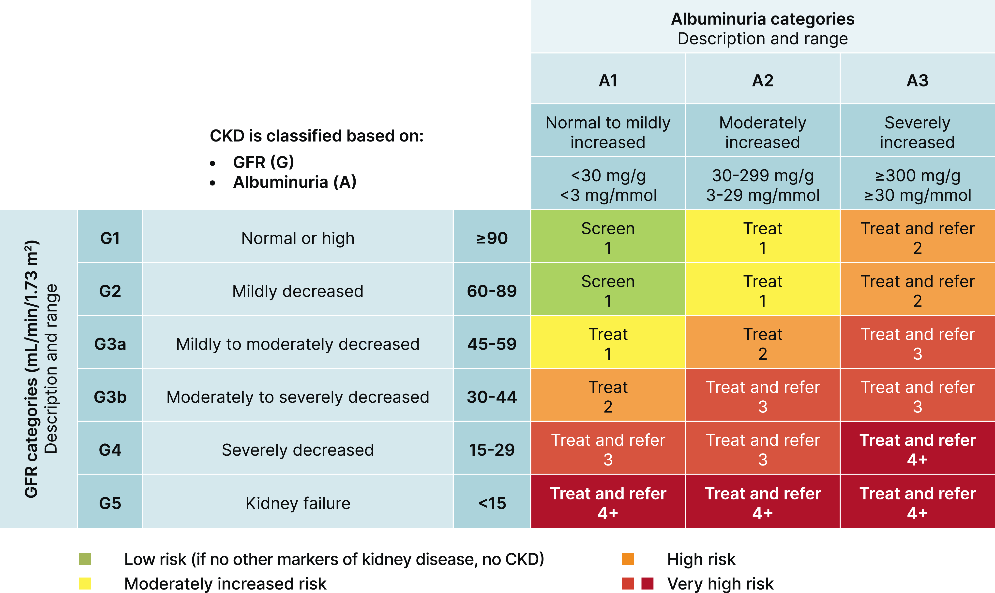
eGFR/UACR Monitoring (Care Gap)
Task will trigger according to recommended frequency on the KDIGO heatmap.
Examples:
A patient with Stage G1/A1 will trigger a task if no eGFR/UACR in the last year
A patient with Stage G4/A2 will trigger a task if no eGFR/UACR in the last 4 months
If there’s no eGFR and/or UACR in the chart to determine the recommended frequency, a task will trigger
Use .DMKIDNEYHEALTH smartphrase in a patient message to coordinate scheduling if this is the only task to be addressed.
Monitoring Legend: 1= Annual; 2= Every 6 months; 3= Every 4 months; 4= Every 3 months
Levin A et al. Kidney International (2024) 105 (Suppl 4S), S117–S314
Jones DW et al; Circulation. 2025.
El Sayed NA, et al. Diabetes Care December 2024, Vol.48, S1-S5.

Slide 51
Optimizations and Clinical Pearls
By Medication Class

Slide 52
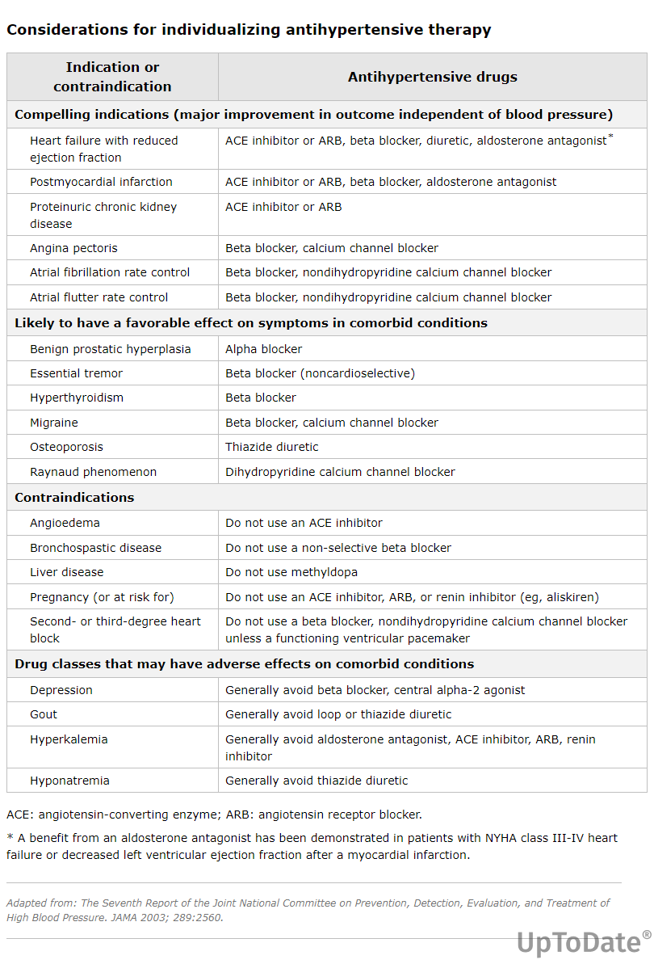
Individualizing Therapy
Jones DW et al; Circulation. 2025.
Whelton, P. K., & Taler, S. J. (2023). Choice of drug therapy in primary (essential) hypertension. In T. W. Post (Ed.), UpToDate.

Slide 53
ACE Inhibitors
Approximate Equipotent Dosing:
Benazepril | 5 mg daily | 10 mg daily | 20 mg daily | 40 mg daily
Lisinopril | 5 mg daily | 10 mg daily | 20 mg daily | 40 mg daily
Ramipril | 1.25 mg BID | 2.5 mg BID | 5 mg BID | 10 mg BID
Optimizations/Clinical Pearls:
Place in Therapy:
1st line option (especially in those with HFrEF, ASCVD, or albuminuria) but ARB preferred due to better side effect profile.
Reasonable to switch to a potent ARB:
If patient is uncontrolled on submaximal dose or BID/TID dose ACE inhibitor.
If ACE-induced cough suspected.
Safety Considerations:
Hyperkalemia
Risk of angioedema (higher than ARBs); If this occurs on an ACE inhibitor, it may compromise future ARB trial due to cross reactivity.
A rise in sCr up to 30% is both normal and expected. A rise of more than 30 % may indicate underlying bilateral renal artery stenosis → discontinue and present at Clinical Roundtable for further investigation.
Risk of AKI, especially in situations when dehydration or nausea/vomiting present.
See Sick Day Management slide for guidance.
Recommended monitoring: Review for appropriate baseline BMP/CMP before starting. Check 2-4 weeks after initiation and then if stable, consider rechecking with subsequent dose changes.
Jones DW et al; Circulation. 2025.
Whelton, P. K., & Taler, S. J. (2023). Choice of drug therapy in primary (essential) hypertension. In T. W. Post (Ed.), UpToDate.

Slide 54
ARBs
Approximate Equipotent Dosing:
Azilsartan^ | - | 40 mg | 80 mg
Candesartan* | 16 mg | 32 mg | -
Irbesartan | 150 mg | 300 mg | -
Losartan | 100 mg | - | -
Olmesartan* | 20 mg | 40 mg | -
Telmisartan^ | 40 mg | 80 mg | -
Valsartan* | 160 mg | 320 mg | -
Optimizations/Clinical Pearls:
Place in Therapy:
1st line option (especially in those with HFrEF, ASCVD, or albuminuria)
Losartan:
Should not be prescribed as 1st ARB choice due to low effectiveness.
Switch losartan to a potent agent regardless of BP control.
Safety Considerations:
Hyperkalemia
A rise in sCr up to 30% is both normal and expected. A rise of more than 30 % may indicate underlying bilateral renal artery stenosis → discontinue and present at Clinical Roundtable for further investigation.
Risk of AKI, especially in situations when dehydration or nausea/vomiting present.
See Sick Day Management slide for guidance.
Recommended monitoring: Review for appropriate baseline BMP/CMP before starting. Check 2-4 weeks after initiation and then if stable, consider rechecking with subsequent dose changes.
*Indicates preferred agent based on potency and expected insurance coverage
^Indicates highest potency agent but may be a higher copay or require prior auth
Jones DW et al; Circulation. 2025.
Whelton, P. K., & Taler, S. J. (2023). Choice of drug therapy in primary (essential) hypertension. In T. W. Post (Ed.), UpToDate.

Slide 55
CCBs
Approximate Equipotent Dosing:
Amlodipine | 2.5 mg | 5 mg | 10 mg | -
Felodipine | 2.5 mg | 5 mg | 10 mg | -
Nifedipine | - | 30 mg | 60 mg-90 mg | 120 mg
Optimizations/Clinical Pearls:
Place in Therapy:
1st line option
Use in combination with ACE/ARB for patients who need initial 2 drug regimen
Starting an ARB (ideally use combination pill) is preferred over titrating amlodipine dose to 10 mg/day if uncontrolled on starting dose, then titrate to max doses of both if needed for BP control.
Consider switching amlodipine to nifedipine in a patient who is close to goal (<5 mmHg), not complaining of edema, and who prefers to avoid additional therapy.
Safety Considerations:
Peripheral edema → see next slides. History of edema during previous trial should be investigated and if causal relationship unclear, a retrial should be considered at a low-to-mid range dose using ≥1 of the strategies on the next slide.
Heartburn/GERD → switch to felodipine (least effect on the esophageal sphincter)
Non-DHP CCBs reserved for those who cannot tolerate other preferred options or if compelling indication exists (Afib).
Jones DW et al; Circulation. 2025.
Whelton, P. K., & Taler, S. J. (2023). Choice of drug therapy in primary (essential) hypertension. In T. W. Post (Ed.), UpToDate.
Makani H, Bangalore S, et al. Am J Med. 2011 Feb;124(2):128-35.

Slide 56
CCBs – Ankle Swelling
If ankle swelling requires intervention, consider one or more of the following:
Starting or maximizing ARB dose if BP is uncontrolled (highest priority).
Switch to bedtime dosing.
Reducing the dose, especially if at max dose.
Switch to BID dosing if patient agreeable.
Switch to felodipine.
Switch to alternative class.
Recommending use of compression stockings.
It is clinically appropriate to prescribe a thiazide in a patient with swelling if the BP remains uncontrolled, despite the swelling not being due to increased plasma volume.
Jones DW et al; Circulation. 2025.
Whelton, P. K., & Taler, S. J. (2023). Choice of drug therapy in primary (essential) hypertension. In T. W. Post (Ed.), UpToDate.
Makani H, Bangalore S, et al. Am J Med. 2011 Feb;124(2):128-35.

Slide 57
CCBs Patient Education – Ankle Swelling
Ankle swelling is one of the most common side effects – in as many as 20-30% of patients.
The ankle swelling can happen because CCBs work by helping the blood vessels dilate. As they dilate it can allow fluid in the blood vessel to escape into the space underneath the skin.
Reducing the amount of sitting during the day can help prevent the swelling or reduce it if present.
The swelling is not dangerous if it happens, but you should notify your Clinician so that it can be addressed. The dose can be reduced, switched to another medication, or if BP control is still not achieved, add another BP medication that can help the swelling.
Once addressed, the swelling typically resolves within days but may take longer in some people.
Jones DW et al; Circulation. 2025.
Whelton, P. K., & Taler, S. J. (2023). Choice of drug therapy in primary (essential) hypertension. In T. W. Post (Ed.), UpToDate.
Makani H, Bangalore S, et al. Am J Med. 2011 Feb;124(2):128-35.

Slide 58
Thiazide Diuretics
Approximate Equipotent Dosing:
HCTZ | 12.5 mg | 25 mg | 50 mg
Chlorthalidone | - | 12.5 mg | 25 mg
Indapamide | 1.25 mg | 2.5 mg | 5 mg
Optimizations/Clinical Pearls:
Place in Therapy:
1st line option but ACE/ARB/CCB typically preferred
Useful in those with osteoporosis, hypocalcemia, and calcium-containing kidney stones
Recommended Approach:
If patient is diuretic-naïve, start chlorthalidone 12.5 mg/day (Note: patient will have to cut ideally using pill cutter. Uneven cuts are okay given the long half life). Increase to 25 mg/day if further control needed AND electrolytes/renal function are stable.
Indapamide may be used in those who cannot tolerate chlorthalidone or prefer to not or cannot cut tablets.
If adherence is a concern and combination therapy or avoiding cutting tablets is preferred, use HCTZ in a combination tablet with other classes.
If patient uncontrolled and already on HCTZ, switch to chlorthalidone or indapamide.
Reserve HCTZ 12.5 mg/day for patients in whom there is a concern about tolerance (e.g., gout flare risk, elderly/frail, etc.).
For patients with CKD4, chlorthalidone is preferred over loop diuretics based on benefit (BP lowering and improved albuminuria) and safety demonstrated in CLICK trial – unless patient exhibiting signs/symptoms of hypervolemia (e.g., SOB, orthopnea, peripheral edema, etc.).
Effectiveness:
Cardiovascular event reduction: Demonstrated with chlorthalidone/indapamide but not HCTZ
BP lowering: Chlorthalidone/indapamide >HCTZ
Safety Considerations: See next slides for more information.
Overall risk profile: chlorthalidone>indapamide>HCTZ
Risk of AKI, especially in situations when dehydration or nausea/vomiting present.
See Sick Day Management slide for guidance.
Jones DW et al; Circulation. 2025.
Whelton, P. K., & Taler, S. J. (2023). Choice of drug therapy in primary (essential) hypertension. In T. W. Post (Ed.), UpToDate.
Musini VM et al. Cochrane Database of Systematic Reviews 2014, Issue 5. Art. No.: CD003824.
Roush GC et al. Hypertension. 2015 May;65(5):1041-6.
Roush GC et al. Hypertension. 2012;59:1110–1117
Ishani AI et al. N Engl J Med 2022; 387:2401-2410
Agarwal R et at. N Engl J Med 2021;385:2507-2519

Slide 59
Thiazide Diuretics – Safety
Hyperuricemia/Gout:
Dose-dependent, normally low risk on low doses.
Risk factors: increasing age, male sex, obesity, kidney dysfunction, excessive alcohol/fructose/purine intake
Prevention and management:
Patient education, especially if decision to use in patients with history
Use other agents to control BP in a patient with history of gout, if possible
If a thiazide is necessary, concomitant use of an ACE/ARB can reduce the risk of hyperuricemia
Orthostatic hypotension:
Risk factors: elderly, any patient with baroreflex receptor or autonomic dysfunction (e.g., diabetic neuropathy, Parkinson disease, etc.), chronic hypovolemia
Prevention and management:
Use other agents to control BP in patients with history or in whom risk factors are present, if possible
If thiazide is deemed necessary, use lowest dose possible
Jones DW et al; Circulation. 2025.
Shahinfar S et al. Kidney Int 56:1879–1885

Slide 60
Thiazide Diuretics – Safety
Electrolyte abnormalities:
Dose-dependent, normally low risk. If occurs, normally mild on low doses.
Data is somewhat conflicting on which agent is associated with higher risk – but may be chlorthalidone >indapamide>HCTZ.
General risk factors: elderly, renal dysfunction, concomitant medications, preexisting electrolyte abnormalities, certain disease states (e.g., heart failure, diabetes, liver cirrhosis), and poor nutritional status.
Hypokalemia: See slides 47-49 for management.
Hyponatremia: Discontinue offending agent and refer to PCP due to complexity of evaluation and management.
Hypercalcemia: Effect may be beneficial in those with osteoporosis and hypoparathyroidism but problematic in those with conditions such as primary hyperparathyroidism.
Monitoring: Review for appropriate baseline BMP/CMP before starting. Check 2-4 weeks after initiation and then if stable, consider rechecking with subsequent dose changes.
Jones DW et al; Circulation. 2025.
Musini VM et al. Cochrane Database of Systematic Reviews 2014, Issue 5. Art. No.: CD003824.
Roush GC et al. Hypertension. 2015 May;65(5):1041-6.
Roush GC et al. Hypertension. 2012;59:1110–1117

Slide 61
Loop Diuretics
Approximate Oral Equipotent Dosing:
Furosemide | 40 mg
Bumetanide | 1 mg
Torsemide | 20 mg
Clinical Pearls:
Place in Therapy: Reserved for uncontrolled patients with CKD4 eGFR 15-29 mL/min/1.73 m² with signs/symptoms of fluid overload.
Preferred agent: Torsemide due to its long duration of action and better bioavailability.
Safety Considerations: Refer to thiazide diuretic safety slides.
Jones DW et al; Circulation. 2025.
Whelton, P. K., & Taler, S. J. (2023). Choice of drug therapy in primary (essential) hypertension. In T. W. Post (Ed.), UpToDate.

Slide 62
Other Diuretics
Clinical Pearls:
Metolazone:
“Thiazide-related” diuretic
Only used once loop diuretic therapy is optimized.
Out of scope for Clinician to prescribe/manage.
Ethacrynic acid
Non-sulfonamide loop diuretic
Only used in those with true hypersensitivity reaction to sulfonamide loop diuretics.
Clinical roundtable discussion required prior to prescribing.
Jones DW et al; Circulation. 2025.

Slide 63
Hypokalemia Protocol
Clinical Background:
Diuretics on their own rarely induce moderate to severe hypokalemia, make sure to assess other potential sources of potassium loss or intracellular shift.
Diuretic-induced hypokalemia may be indicative of an aldosterone-excess state and therefore should be investigated according to the algorithm on Slide 19.
Diuretic hypokalemia is usually associated with a mild to moderate metabolic alkalosis (serum bicarbonate of 28-36 mmol/L)
General Prevention:
Encourage optimal intake of dietary potassium:
Aim for about 3,500-5,000 mg per day.
Send patient information on potassium content of food and log (Table 1 on next slide).
Encourage moderate sodium restriction (<2,000 mg).
Assess for other reasons for underlying K loss (Tables 2 and 3 on next slide) and correct if able or refer to PCP.
Jones DW et al; Circulation. 2025.
Cohn JN et al. Arch Intern Med. 2000;160:2429-2436

Slide 64
Hypokalemia Protocol
Table 1: High Potassium Foods
Highest Content >1,000 mg/100 g Dried figs Molasses |  | Very High Content > 500 mg/100 g Dried fruits (dates, prunes) Nuts Avocados Bran cereals Lima beans
High Content >250 mg/100 g
Vegetables Spinach Tomatoes Broccoli Squash Beets Cauliflower Carrots Potatoes | Fruits Bananas Cantaloupe Kiwi Oranges Mangos |  | Meats Ground beef Steak Pork Lamb Veal
Table 2: Medications that can cause hypokalemia
Transcellular Shifts | Renal Loss | Gastrointestinal Loss
High dose insulin Beta adrenergic agonists, verapamil intoxication, caffeine, theophylline | Diuretics Acetazolamide Hydrochlorothiazide Chlorthalidone Furosemide Mineralocorticoids (fludrocortisone) High dose glucocorticoids High dose penicillin Magnesium loss PPIs Aminoglycosides Cisplatin Foscarnet amphotericin | Laxatives Senna Sodium polystyrene
Table 3. Other Causes of Hypokalemia
High dietary Na intake Hypomagnesemia Prolonged diarrhea Vomiting Primary/secondary aldosteronism Cushing syndrome Bartter or Liddle Syndrome Stress/catecholamines
Jones DW et al; Circulation. 2025.
Cohn JN et al. Arch Intern Med. 2000;160:2429-2436

Slide 65
Hypokalemia Protocol
General Treatment Approach:
Replete potassium according to table below.
Once potassium is repleted, investigate for primary aldosteronism according to Slide 19.
Add or intensify potassium-sparing medication (e.g., ARB, potassium-sparing diuretic).
If at maximally tolerated doses of the options in Step 3, consider:
Decreasing diuretic dose
Switching chlorthalidone/indapamide to hydrochlorothiazide
Presenting case at Clinician Case Review for further investigation
Potassium Repletion
Serum K mmol/L | Dose Recommended | Repeat labs
3.3-3.4 | 10 mEq BID x 2 days | 2-4 days; repeat if necessary
3.0-3.2 | 20 mEq BID x 2 days
< 3.0 or symptomatic | Refer to the ED; 20 mEq BID x 3 days
Jones DW et al; Circulation. 2025.
Cohn JN et al. Arch Intern Med. 2000;160:2429-2436
Macdonald JE et al. J Am Coll Cardiol. 2004;43(2):155-161.
Kovesdy CP et al. Am J Kidney Dis. 70(6):844-858.
Kardalas E et al. Endocrine Connections. 2018;7:135-146

Slide 66
Potassium-sparing Diuretics
Optimizations/Clinical Pearls:
Agents:
Place in Therapy:
4th line option, or
Earlier in treatment if primary aldosteronism diagnosed
May be used to offset ongoing thiazide diuretic-induced potassium wasting.
Safety Considerations:
Hyperkalemia → Avoid use with K+ containing supplements.
Risk of AKI, especially in situations when dehydration or nausea/vomiting present.
See Sick Day Management slide for guidance.
Recommended Monitoring: Review for appropriate baseline BMP/CMP before starting. Check 2-4 weeks after initiation and then if stable, consider rechecking with subsequent dose changes.
Spironolactone:
Preferred agent in patients with resistant HTN or as GDMT in HFrEF
Risk of gynecomastia and ED at higher doses → use ≤50 mg/day unless primary aldosteronism
Do not start when K+ ≥5 mEq/L
Eplerenone:
Use if concern for gynecomastia/ED (lower risk than spironolactone)
Less potent → typically requires BID dosing
Do not start when K+ ≥5 mEq/L
Amiloride:
Reserve for those who cannot tolerate or wish to avoid the potential side effects of MRAs
May be as effective as spironolactone in resistant HTN
Do not start when K+ ≥5 mEq/L
Triamterene:
Not effective a single agent → Do not use unless in combination with HCTZ
Jones DW et al; Circulation. 2025.
Whelton, P. K., & Taler, S. J. (2023). Choice of drug therapy in primary (essential) hypertension. In T. W. Post (Ed.), UpToDate.
Williams B et al. Lancet Diabetes Endocrinol. 2018 Jun;6(6):464-475.

Slide 67
Hyperkalemia Protocol
Clinical Background
Hyperkalemia is a common issue that is most often a result of impaired urinary potassium excretion due to acute or chronic kidney disease (CKD) and/or disorders or drugs that inhibit the RAAS.
Typically does not cause symptoms until severe (K >6.5 mEq/L when palpitations and muscle pain/weakness/numbness can occur. The main concern is the occurrence of an abnormal heart rhythm which can cause a cardiac arrest. These patients require immediate emergency medical attention.
Patients with mild to moderate elevations without symptoms typically do not require urgent lowering.
General Treatment Approach
Initial Management (for patients enrolled in HTN and on ACE/ARB/MRA or Clinician ordered the lab):
Follow pathway on the next slide to determine ED precautions and short-term clinical intervention.
Instruct patient to hold any potassium supplementation.
Provide education or coordinate with PCP to help correct any acute causative factors, if present:
Dehydration → Encourage adequate fluid intake with electrolytes.
NSAID use → Encourage them to hold or decrease the use, if possible.
If potassium elevation likely related to CKD, provide education about dietary potassium intake and consider reduction if appropriate based on current estimated intake.
Patient resource: Low Potassium Diet
Smartphrase: .dmlowpotassium
Long-term Management Considerations:
Assess current diuretic therapy and optimize to prevent future hyperkalemia:
If patient is on HCTZ, consider switch to chlorthalidone for more potent effect.
If patient not on a thiazide, consider starting chlorthalidone especially if BP uncontrolled.
Ensure that ACE/ARB/MRA therapies are restarted once potassium (and renal function, if applicable) stable – especially in patients with HFrEF or albuminuria.
Recheck BMP in 2-4 weeks after restarting medication in Step 2.
Whelton PK et al. Hypertension. 2018;71:e13–e115.
Mount, D. B. (2024). Treatment and prevention of hyperkalemia in adults. In UpToDate.
Cohn JN et al. Arch Intern Med. 2000;160:2429-2436

Slide 68
Hyperkalemia Protocol

Slide 69
Beta-Blockers
Approximate Equipotent Dosing:
Atenolol* | 25 mg daily | 50 mg daily | 100 mg daily
Bisoprolol | 2.5 mg daily | 5 mg daily | 10 mg daily
Carvedilol | 6.25 mg BID | 12.5 mg BID | 25 mg BID
Labetalol | 100 mg BID | 200 mg BID | 400 mg BID
Metoprolol | 50 mg daily | 100 mg daily | 200 mg daily
Nebivolol | 5 mg daily | 10 mg daily | 40 mg daily
Optimizations/Clinical Pearls:
*Not preferred due to poor effectiveness
Place in Therapy:
5th line option unless there is a compelling indication (e.g., post-MI, HFrEF, Afib, portal HTN) to use earlier.
For patients with portal HTN, carvedilol is the agent of choice.
If uncontrolled on cardioselective agent, switch to carvedilol.
If uncontrolled on carvedilol, consider switch to labetalol.
Taper dose slowly if discontinuing completely.
Safety Considerations:
Bradycardia (HR <60 bpm): if this occurs with symptoms (e.g., lightheadedness, dizziness, cognitive slowing, exercise intolerance), reduce the dose.
If it persists despite dose reduction, refer to PCP for further evaluation.
Worsened lung function:
Avoid use in patients with severe or decompensated bronchospastic disease.
Use cardioselective agents and beta/alpha blockers (carvedilol, labetalol) with caution in patients with mild to moderate disease.
Jones DW et al; Circulation. 2025.
Whelton, P. K., & Taler, S. J. (2023). Choice of drug therapy in primary (essential) hypertension. In T. W. Post (Ed.), UpToDate.
Sirak TE et al. J Am Coll Cardiol. 2004;44(3):497.

Slide 70
Centrally Acting Agents
Optimizations/Clinical Pearls:
Preferred Agent:
Place in Therapy:
A 5th line option for those who cannot tolerate or have a contraindication to beta-blockers.
May be used PRN for severely high BP fluctuations with very clear patient education for use.
Less ideal options because of their need for BID to TID dosing, predisposition to BP lability, and for clonidine, difficulty getting patients off.
Safety Considerations:
Associated with significant CNS AE’s (fatigue, sleepiness, dry mouth, etc.) leading to high nonadherence/discontinuation rates.
Must taper dose slowly to prevent rebound HTN.
Clonidine:
Patch preferred due to convenience but also most expensive.
Dermatitis is a common side effect.
Guanfacine
Dosed once daily at bedtime.
Can be useful in concomitant ADD.
Jones DW et al; Circulation. 2025.

Slide 71
Alpha Blockers
Optimizations/Clinical Pearls:
Agents:
Place in Therapy:
Typically used as last line options.
Alpha-1 adrenergic receptor blockers that prevent norepinephrine from causing vasoconstriction → leads to arterial and venous dilation, decreased SVR, and reduced BP.
Safety Considerations:
Avoid in patients with heart failure due to significantly increased risk shown in clinical trials.
Orthostatic hypotension and falls:
Common with first few doses; risk is higher in older adults and those with volume depletion.
Do not use in someone with active orthostatic hypotension.
Do not use in combination with centrally acting agents.
Peripheral edema
Reflex tachycardia
Terazosin:
Longer duration of action than prazosin. Dosed once daily.
Can be useful for concomitant BPH.
Doxazosin:
Longest duration of action than prazosin. Dosed once daily.
Can be useful for concomitant BPH.
Prazosin:
Shortest duration of action but dosed once daily at bedtime.
Can be useful for concomitant PTSD-related nightmares or BPH.
Jones DW et al; Circulation. 2025.
Carey, R. M. (2023). Treatment of resistant hypertension. In T. W. Post (Ed.), UpToDate.

Slide 72
Direct Vasodilators
Optimizations/Clinical Pearls:
Agents:
Place in Therapy:
Typically used as last line options.
Hydralazine promotes significant blood pressure lability, can worsen edema due to its potent vasodilatory effects, and overall tends to make patients feel poorly.
Safety Considerations:
Peripheral edema is common → typically requires loop diuretic.
Reflex tachycardia is also common →ideally used with beta-blocker.
Hydralazine:
Lupus-like syndrome is possible AE, especially on doses ≥200 mg/day.
Presents as severe fatigue/myalgias, acute joint pain and swelling.
Reversible upon discontinuation.
Minoxidil:
Clinical roundtable discussion required prior to prescribing.
Associated with serious AE’s.
Hirsutism is common.
Isosorbide
Not within Clinician scope to adjust dosing as it is not used as an antihypertensive but okay to renew prescription if requested.
Nitrate used for angina.
Can cause dizziness and hypotension.
Jones DW et al; Circulation. 2025.
Carey, R. M. (2023). Treatment of resistant hypertension. In T. W. Post (Ed.), UpToDate.

Slide 73
Sick Day Management
Jones DW et al; Circulation. 2025.
This slide provides guidance on when to temporarily hold medications during acute illness to prevent harm from dehydration, hypotension, or acute kidney injury.
Use this guidance to support clinical decision-making during common intercurrent illnesses like vomiting, diarrhea, or poor oral intake.
The goal is to reduce medication-related complications while maintaining safe blood pressure control until the patient is clinically stable.
Medication Class | Recommendation During Illness | Reason
Diuretics | Hold if dehydrated or poor oral intake | Risk of dehydration, hypotension, acute kidney injury (AKI), electrolyte abnormalities
ACE inhibitors/ARBs | Hold if hypotensive, dehydrated, or AKI | Risk of worsening AKI during volume depletion
Calcium Channel Blockers | Usually continue unless severe hypotension | Less risky for AKI; hold if hypotensive
Beta-Blockers | Continue cautiously, monitor for bradycardia or hypotension | Can be continued if BP and heart rate are stable; watch for symptomatic bradycardia or hypotension
Centrally acting agents | Generally, continue if possible. Do NOT stop abruptly. | Risk of rebound hypertensive crisis if suddenly stopped.
Alpha Blockers | Hold if symptomatic hypotension | Risk of orthostatic hypotension exacerbation during illness
Direct Vasodilators | Hold if symptomatic hypotension | Can worsen hypotension
NSAIDS (not a HTN class but still important) | Hold if vomiting or dehydrated | Risk of AKI

Slide 74
When to Escalate (not an all-inclusive list)
Escalate to Clinician Case Review to:
Receive assistance on the next best step in management.
Develop an approach to patient clearly indicated for a specific therapy that they are currently resistant to.
Discuss a tentative medication plan that you may be hesitant to act on.
Brainstorm other possible factors of pseudoresistance for a specific patient.
Discuss whether a patient for whom all interventions have been exhausted is a clinical outlier or discharge.
Escalate to Clinical Roundtable to:
Any patient situation that is unresolved by Clinician Case Review.
Discuss very complex patient cases or those with severe disease.
Escalate to Clinician Supervisor to:
Discuss discharge of any patient that develop any exclusion criteria.

